Slide 1
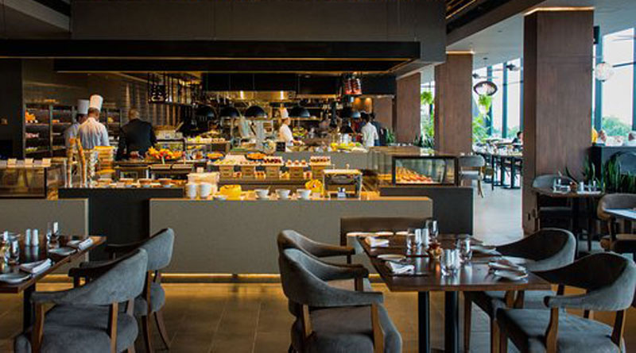
PICKING A SUITABLE LOCATION FOR A NEW RESTAURANT
in Western Singapore

Slide 2
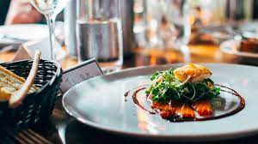
INTRODUCTION
A restaurant is a business that prepares and serves food and drinks to customers. Meals are generally served and eaten on the premises, but many restaurants also offer take-out and food delivery services. Restaurants vary greatly in appearance and offerings, including a wide variety of cuisines and service models ranging from inexpensive fast-food restaurants and cafeterias, to mid-priced family restaurants, to high-priced luxury establishments.

Slide 3

DATA
To perform the analysis, the following data will be used.
List of cities in Singapore.
Geo-coordinates of each city in Singapore
Top venues in the cities in western region.

Slide 4

OBJECTIVE
The study has been focused on a business scenario where the owner of a high-end restaurant chain is deciding to open a new restaurant in the Western Region of Singapore since he is not having a restaurant in Singapore. He is uncertain about the city which he will choose to open the restaurant. The intention of the study is to find an optimal location in the western region for his restaurant.

Slide 5
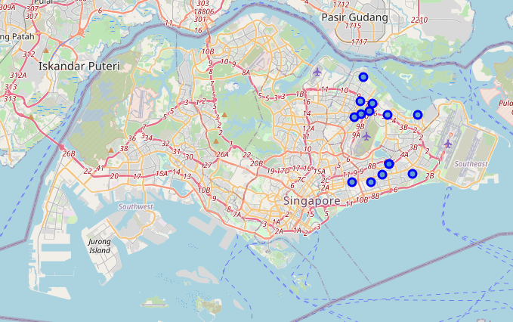
ANALYSIS
An overview of the cities in Singapore.
Out of 75 cities obtained, only the cities in western region were considered.

Slide 6
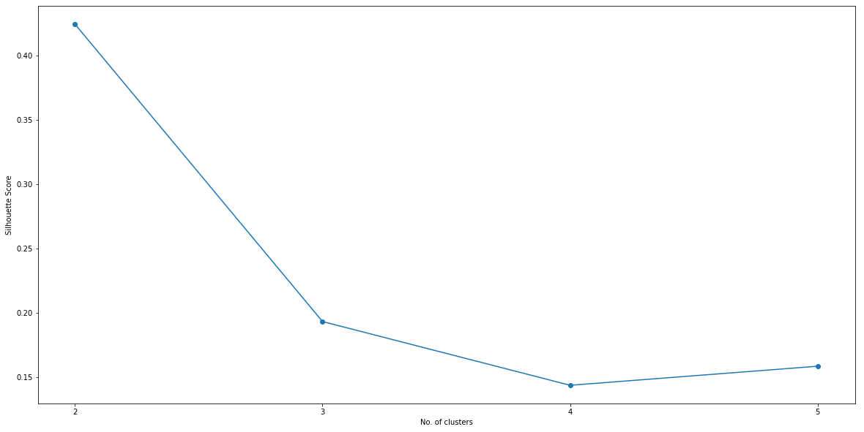
Silhouette Method
To identify the optimal number of clusters the silhouette method was used.
The optimal number of clusters = 2

Slide 7
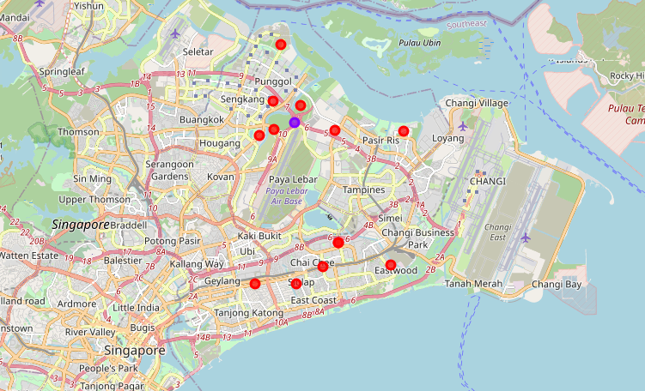
The clusters obtained
Two clusters have been obtained.
The red dot ones are the most suitable cities for restaurants.
The Blue dot cities should be avoided.

Slide 8

LIMITATIONS OF THE STUDY
The analysis was performed only on 75 cities in Singapore.
The analysis on performed on city level.
When collecting the venues, a 1000-meter radius was considered, and the number of collected venues for each city was limited to 100.
In the clustering process only the top 10 venues in each city in western Region of Singapore was considered.

Slide 9

CONCLUSIONS
Based on the results we’ve obtained, we can advise the restaurant owner to consider the cities in the cluster 1, which are the perfect locations for opening a restaurant. These are the cities where coffee shops, restaurants are very frequent. And he should avoid the cities under cluster 2, where no type of restaurant is preferred going to.

Slide 10
THANK YOU

